Slide 1

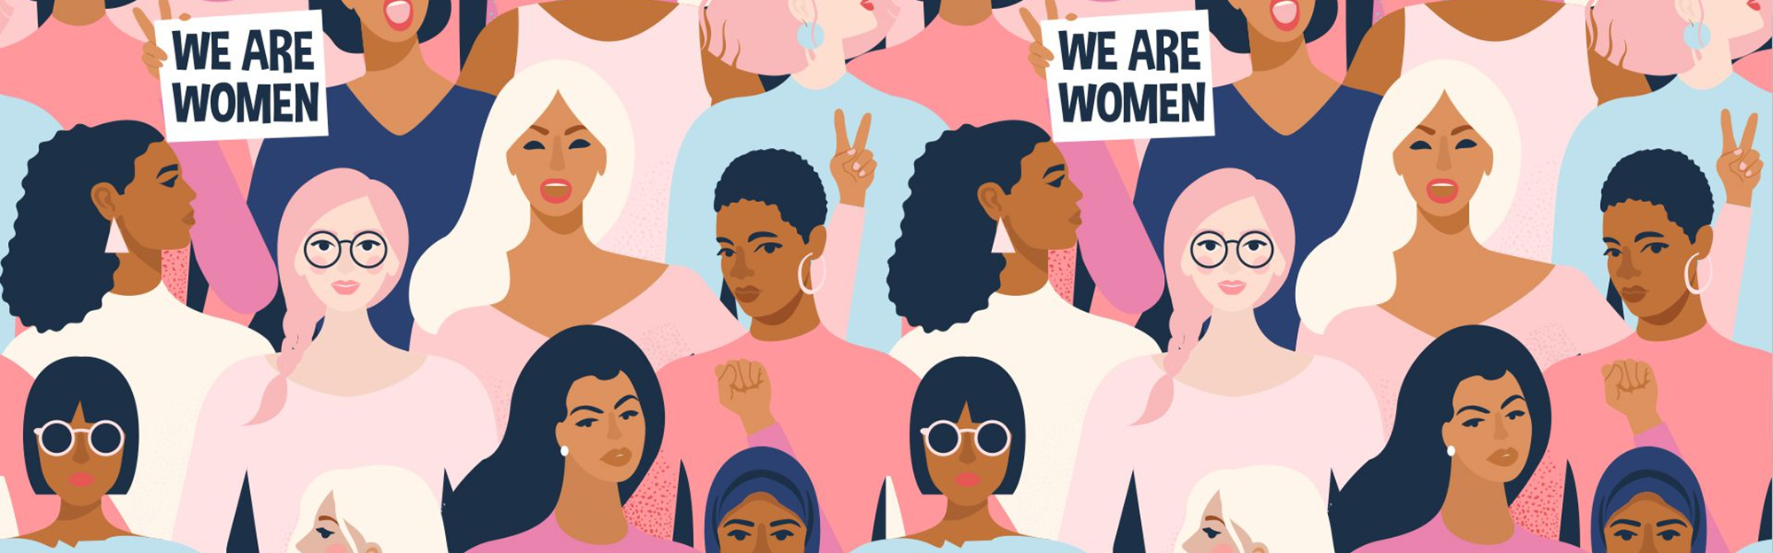
How social media is changing the feminist movement
Alla Topp
MSDS 620 – Data Science Ethics

Slide 2
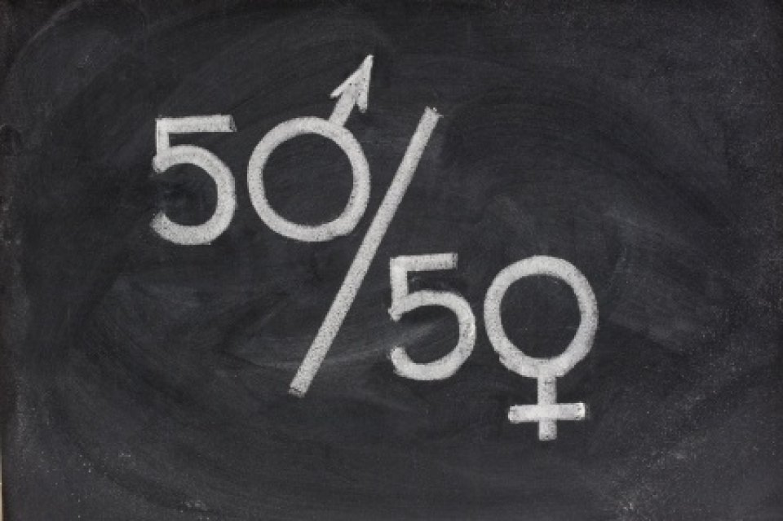
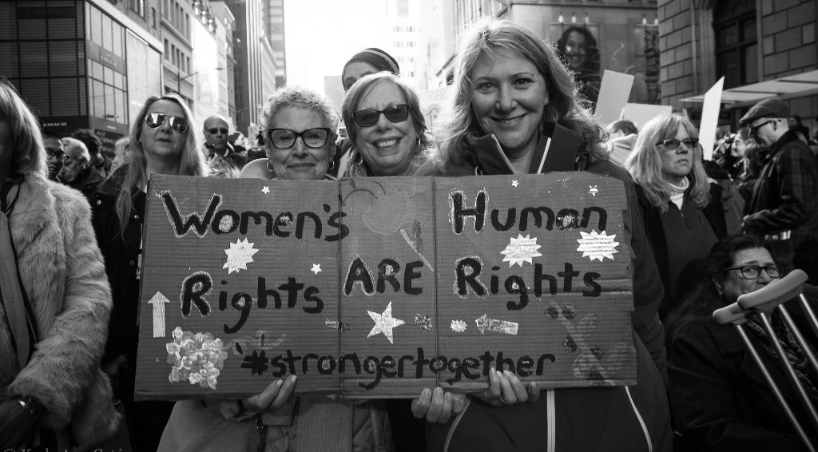
Introduction
Social media has helped women grow and evolve, giving them the courage to speak openly and reveal sexual offenders, unfair treatment at work or in the society, and sexist work environment.
Social media has become the refuge for many women who can now directly address the misogynist ideology and make their voices heard.
Women started to change the history by “calling out” the politicians and leaders and revealing their behaviors.
Even though the society has evolved a lot, women are still not given their place in the traditional media.
The most powerful weapon of feminism now is the hashtag.

Slide 3
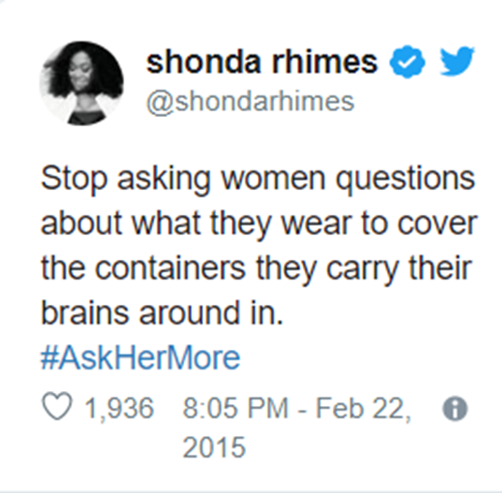
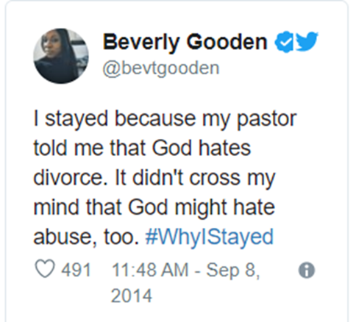
Description
As a data scientist I am trying to research and gather information on gender inequality using social media for this project.
The goal of the project is to gather social media data to see how powerful social media can be to solve gender inequality problems today.
Mind map will be included for visual representation of social media topic, social justice problem issues and its examples.
Additionally, this project will include the ethical and privacy issues that feminist movement faces in social media

Slide 4
Purpose of the project is:
To see how social media can help to solve gender inequality, unfair treatments,
Identify what ethical and privacy issues that affect women has on social media
Identify what social media helps to promote gender inequality
How feminist movement use social media to promote gender inequality

Slide 5
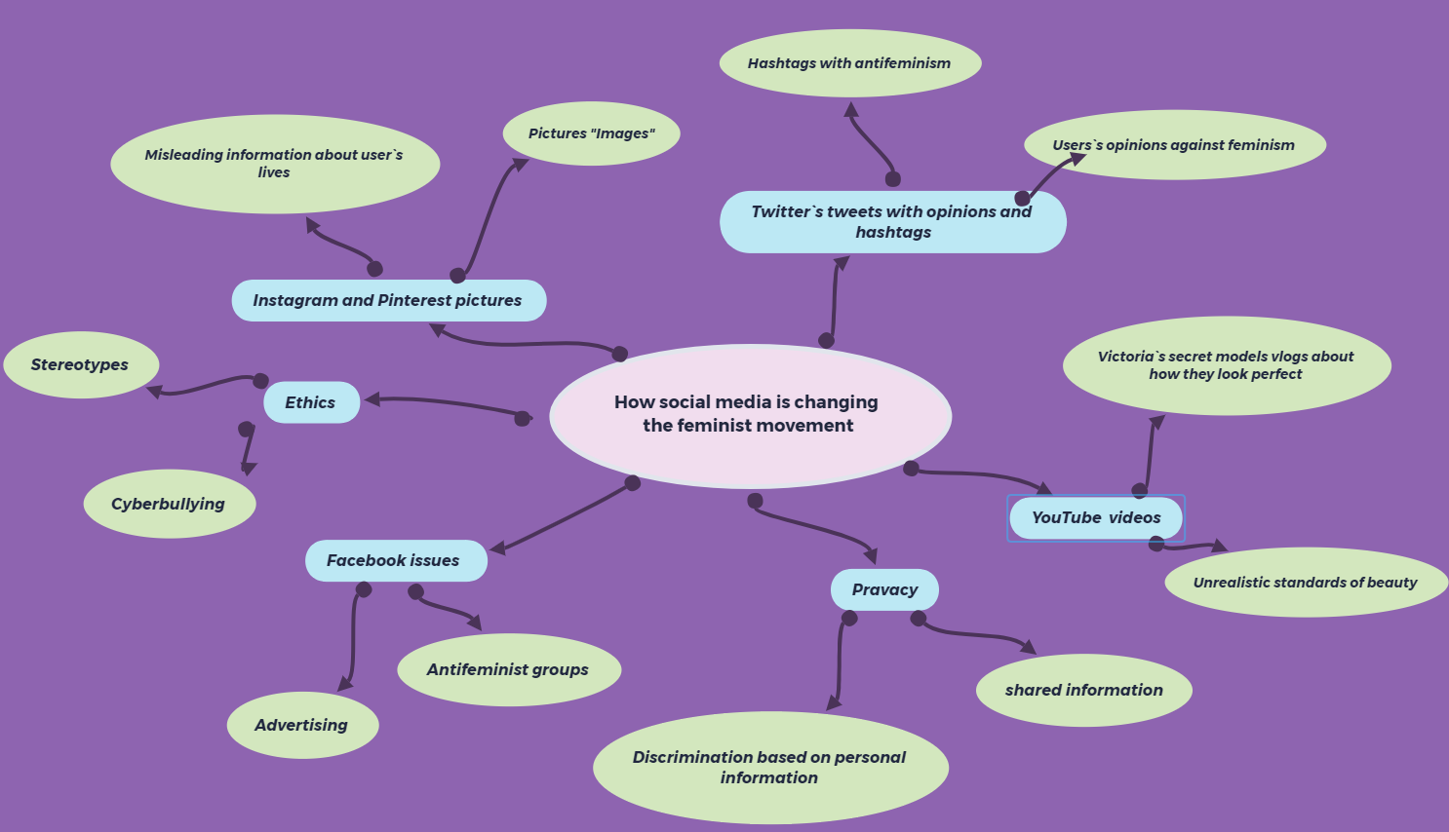

Slide 6

Ethical Issues
Social media promotes stereotypes
Women can be discriminated against by employers based on social media
People on social media could be very harsh and share a negative attitude and opinion about women, for example, “a good wife should have kids, clean the house and cook”
Women can be victims of cyberbullying
The prevalence of trolling is causing considerable concern, with women facing the worst of the abuse. It is often personal, sexist and wounding.
Notes:
Stereotypes examples: what is a perfect woman`s body is like, what`s considered beautiful, that perfect woman is thin and pale, perfect breast size is D, perfect eyes color is blue and so on

Slide 7
Privacy Issues
Social media gives employers a chance to screen for personal information which can be used against women and discriminate against them based of gender
Since social media has a lot of personal information, that makes it very easy for the information to be shared

Slide 8
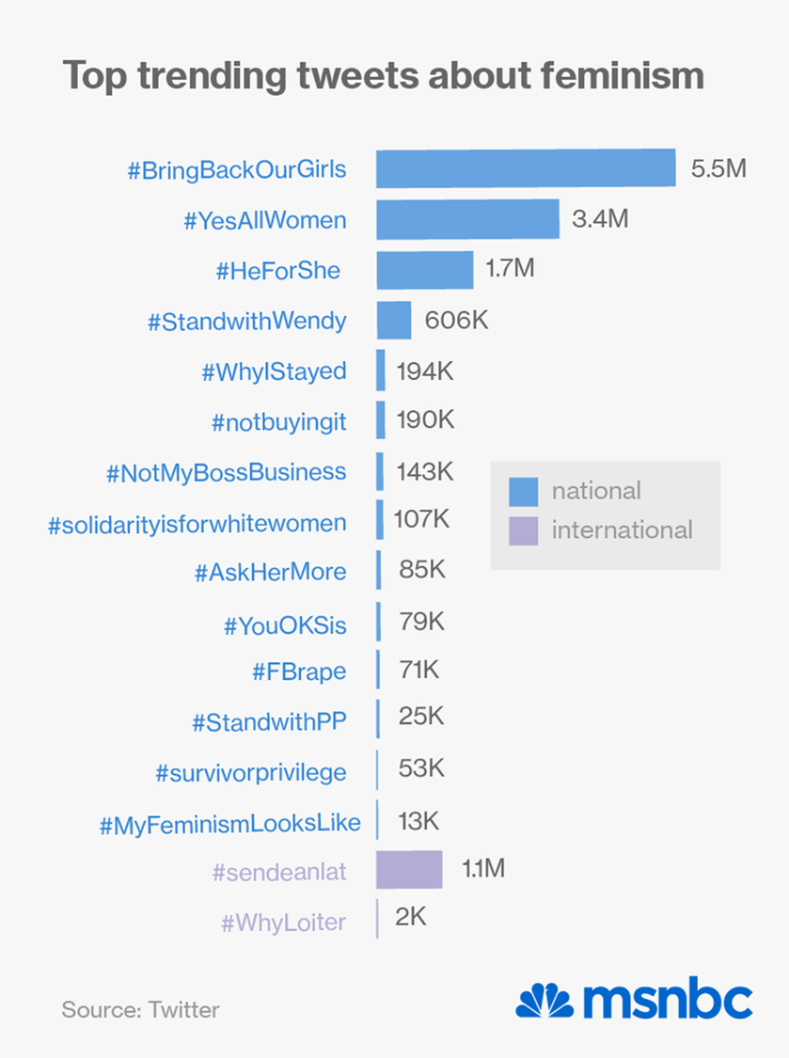
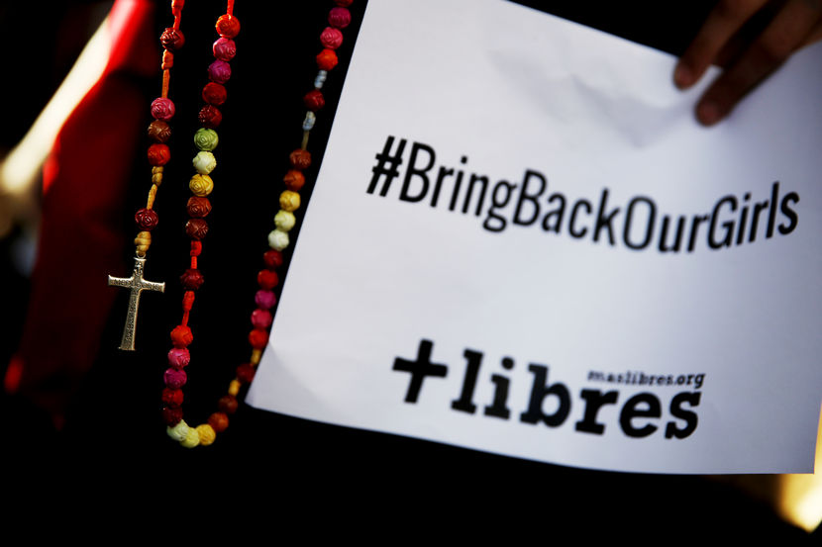
Statistics

Slide 9

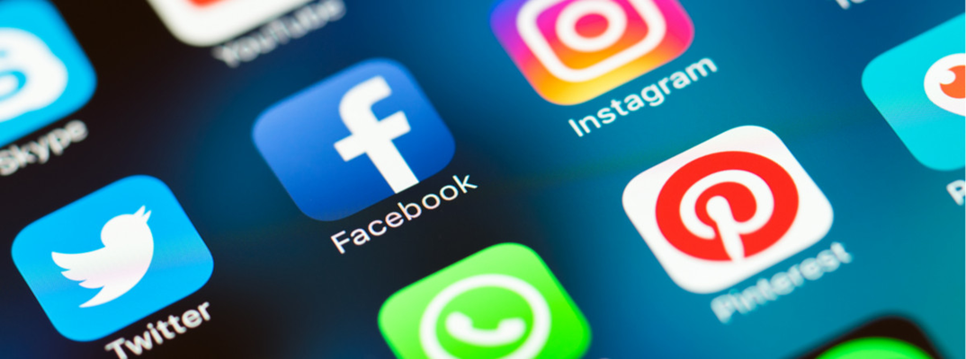
Summary
Mind map showed what social network could cause the issues in feminist movement, those include ethical and privacy issues with at least two branches with examples.
On the positive note, social media democratized feminist activism, opening up participation to anyone with a Twitter account and a desire to fight the patriarchy. By removing the barriers of distance and geography, sites like Facebook, Twitter, Tumblr, and Instagram have made activism easier than ever, facilitating public dialogues and creating a platform for awareness and change.

Slide 10
References
Worldclass.regis.edu, worldclass.regis.edu/d2l/le/content/235028/viewContent/3236477/View.
Chittal, N. (2015, April 06). How social media is changing the feminist movement. Retrieved from http://www.msnbc.com/msnbc/how-social-media-changing-the-feminist-movement
The Five Main Issues Facing Modern Feminism. (n.d.). Retrieved from https://www.newstatesman.com/v-spot/2013/05/five-main-issues-facing-modern-feminism
How Has Social Media Impacted The Current Feminist Movement Around The World? (2018, September 05). Retrieved from https://girltalkhq.com/how-has-social-media-impacted-the-current-feminist-movement-around-the-world/

Slide 11
Thank you!

